Slide 1
This is a hidden slide
Dear honorable teacher please follow the instructions that has given in the slide notes (under the every slide). It would be helpful to take a successful class. Thanks a lot. I wish you good luck.

Slide 2
WELCOME

Slide 3
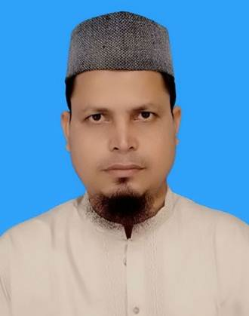
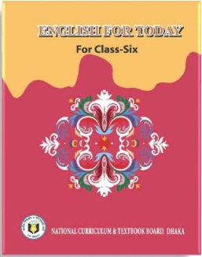
Identity
SK. Md. Harunar Rashid – SAT
Sonatola Model High School
Sonatola, Bogra.
01714622498.
Class : Six
English For Today
Lesson : 9

Slide 4
Let`s enjoy a Hason Raja’s song.
What about the song ?
This songs about Hason Raja.
Notes:
After showing this video teacher can ask his/her students – What did Hason Raja think about mankind, death and life of here and here after ?

Slide 5
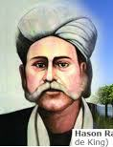
Lesson Declaration
Today we `ll discuss about
Hason Raja :
The mystic bard of Bangladesh
( Lesson – 21 )

Slide 6
Learning outcomes
By the end of this lesson students will be able to -
read and understand texts through silent reading.
infer meaning from context
Listen for information.
ask and answer questions
Write answers to questions.

Slide 7
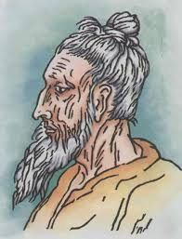
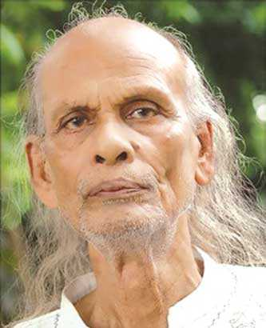
Look at the picture
Do you know who they are or anything about them?
Lalon Shah
Hason Raja
Shah Abdul Karim
Now go to unit 21, section – A. Read the passage carefully and find out who they are.

Slide 8
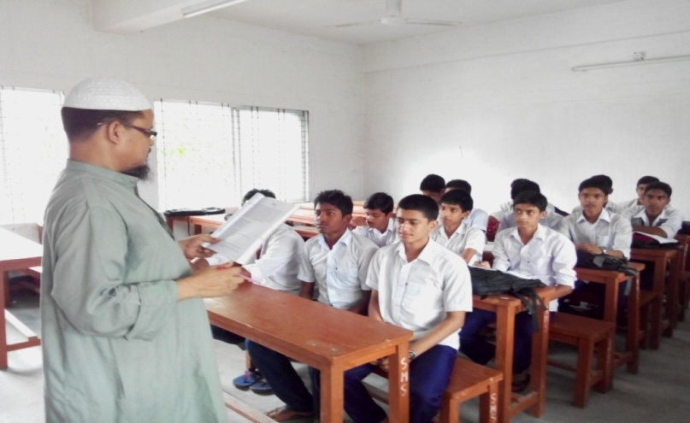
Model Reading
Close your book, listen me attentively then ask and answer the following questions with your partner.
When was Hason Raja born ?
Where did he come from ?
What was his childhood life ?
Why did Hason Raja leave the life of comfort and pleasure ?
What was the other name by which Hason Raja was known ?
Notes:
Teacher can ask to his/her ss to do orally or written.

Slide 9
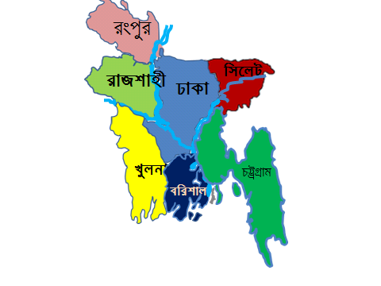
Identity of Hason Raja
Hason Raja was born in 1854 in a wealthy landlord`s family in Sylhet.
Notes:
Teacher will discuss about Hason Raja with pictures.

Slide 10
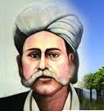
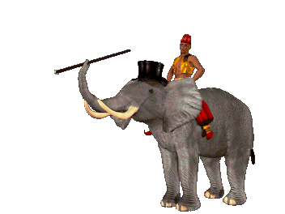
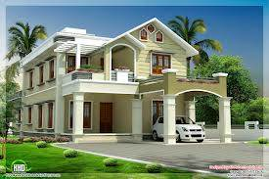
His previous life style
Do you know Hason Raja`s previous life style?
In his youth, he led a life of luxury. He did not lack anything – money, comfort or pleasure. But then a time came when he started to find all these comfort and joy meaningless.
Notes:
Teacher will discuss about Hason Raja with pictures.

Slide 11
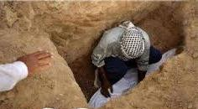
Thought of Hason Raja.
Discuss with your partner about the below picture
Hason Raja gave away his landed property, his money and wealth and started to think deeply about the Creator, about life and death of mankind.
Notes:
Teacher will discuss about Hason Raja with pictures.

Slide 12
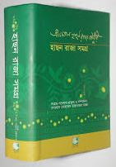
Writer Hason Raja.
Do you know the name of Hason Raja`s book?
The Hason Udas
The Hason Raja Samagr
Hason Raja wrote a lot of songs, perhaps about a thousand in number. His boods called “Hason Udash” and “Hason Raja Samagra”.
Notes:
Teacher will discuss about Hason Raja with pictures.

Slide 13
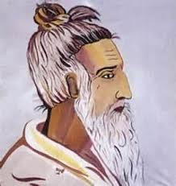
A bard
Key word
They are mystic bards of Bangladesh.
Meaning
(Click here)
Who writes poems and songs.
Notes:
First, the word can be shown. The SS can be asked to pronounce the word. If it is needed teacher can help. Then the picture can be shown and asked to guess the meaning. Then the meaning can be shown. Then they can be asked to make a sentence. Teacher can show the sentence for the feedback.

Slide 14
A mystic
Key word
Hason Raja is a mystic bard of Bangladesh.
Who tries to search the truth and become united with God through prayer and meditation.
Meaning
(Click here)
Notes:
First, the word can be shown. The SS can be asked to pronounce the word. If it is needed teacher can help. Then the picture can be shown and asked to guess the meaning. Then the meaning can be shown. Then they can be asked to make a sentence. Teacher can show the sentence for the feedback.

Slide 15
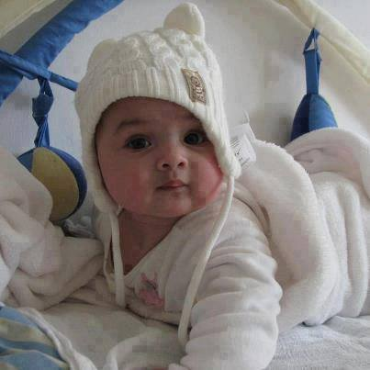
Comfortable
Key word
The baby has been living a comfortable life.
Meaning
(Click here)
The state of having a pleasant life
Notes:
First, the word can be shown. The SS can be asked to pronounce the word. If it is needed teacher can help. Then the picture can be shown and asked to guess the meaning. Then the meaning can be shown. Then they can be asked to make a sentence. Teacher can show the sentence for the feedback.

Slide 16
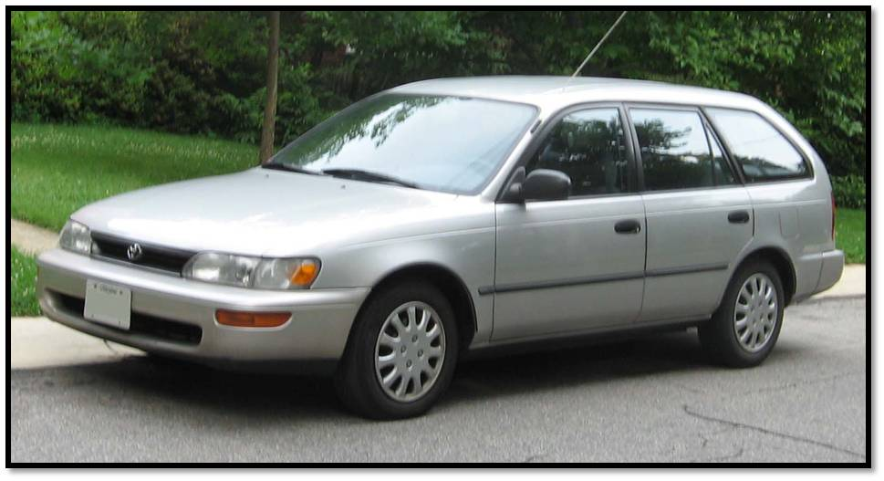
Luxury
Key word
The car is a luxurious vehicle.
Meaning
(Click here)
The enjoyment of expensive things.
Notes:
First, the word can be shown. The SS can be asked to pronounce the word. If it is needed teacher can help. Then the picture can be shown and asked to guess the meaning. Then the meaning can be shown. Then they can be asked to make a sentence. Teacher can show the sentence for the feedback.

Slide 17
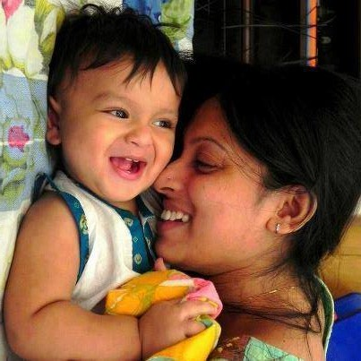
Pleasure
Key word
They lead a pleasurable life.
Meaning
(Click here)
Enjoyment / delight.
Notes:
First, the word can be shown. The SS can be asked to pronounce the word. If it is needed teacher can help. Then the picture can be shown and asked to guess the meaning. Then the meaning can be shown. Then they can be asked to make a sentence. Teacher can show the sentence for the feedback.

Slide 18
Volume
Key word
This is a volume of Hason Raja that contained 500 poems and songs.
Meaning
(Click here)
A large book
Notes:
First, the word can be shown. The SS can be asked to pronounce the word. If it is needed teacher can help. Then the picture can be shown and asked to guess the meaning. Then the meaning can be shown. Then they can be asked to make a sentence. Teacher can show the sentence for the feedback.

Slide 19
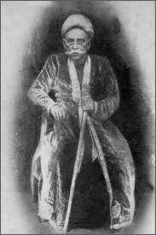
Crazy
Key word
In his songs Hason Raja called himself ‘Crazy Hason Raja’.
Meaning
(Click here)
Excited about something / mad.
Notes:
First, the word can be shown. The SS can be asked to pronounce the word. If it is needed teacher can help. Then the picture can be shown and asked to guess the meaning. Then the meaning can be shown. Then they can be asked to make a sentence. Teacher can show the sentence for the feedback.

Slide 20
Individual Work
Put a word in the gaps from the box matching their meanings.
comfort
luxury
pleasure
volume
crazy
a. ---------------- = enjoyment / happy.
b. ----------------- = a large book.
c. ------------------ = excited about something.
d. ----------------- = the state of having a pleasant life.
e. ----------------- = the enjoyment of expensive things.
Notes:
Teacher can use blackboard by the students.

Slide 21
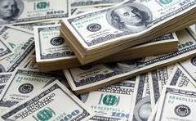
Pair works
Look at the following picture and write the answer of following question :
What was Hason Raja`s childhood life ?
Notes:
Teacher can discuss shortly about Hason Raja`s childhood.

Slide 22
Home work
Write a short paragraph about another mystic bard of Bangladesh
‘LALON SHAH’.
Notes:
Teacher can discuss about Lalin Shah.

Slide 23
Acknowledgement
We would like to express our cordial gratitude to the Ministry of Education, Directorate of Secondary & Higher Education, NCTB, a2i
and
the panel of honorable editors ( Md. Jahangir Hasan, Associate Professor (English) TTC, Rangpur, Ranjit Poddar, Associate Professor (English) TTC, Dhaka, and Urmila Ahmed, Associate Professor (English) TTC, Dhaka, to enrich the contents.

Slide 24
THE END

